Slide 1
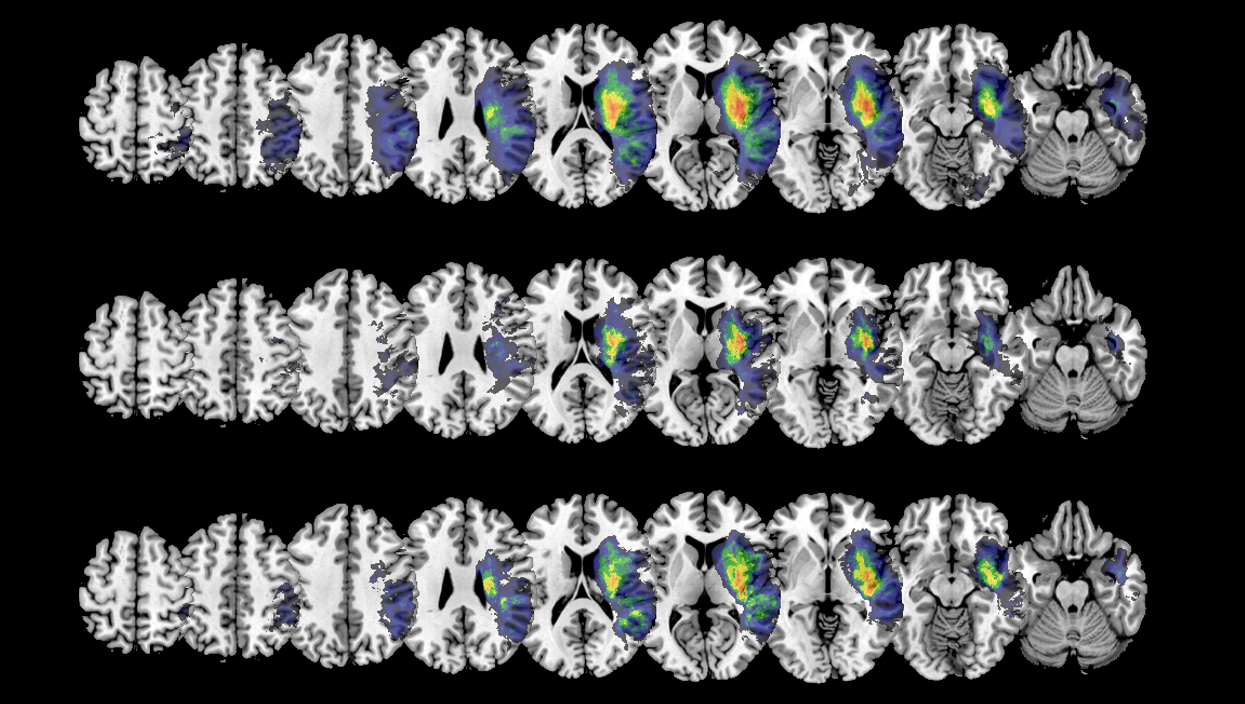
Interim Results
Master Thesis: Sex Differences in the Association of Disconnections with Neglect

Slide 2
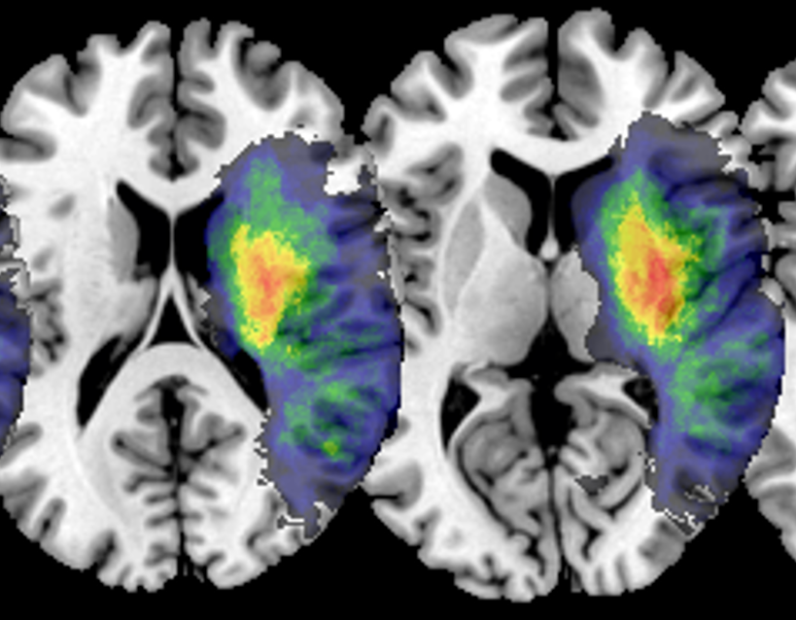
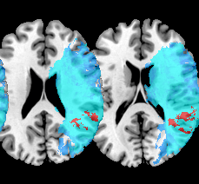
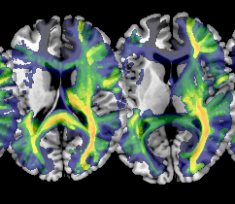
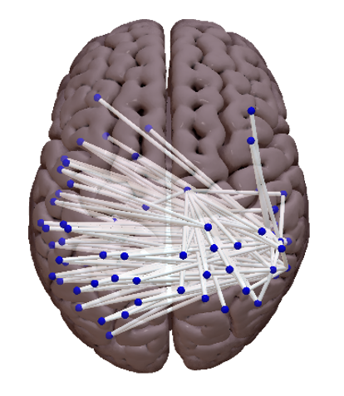
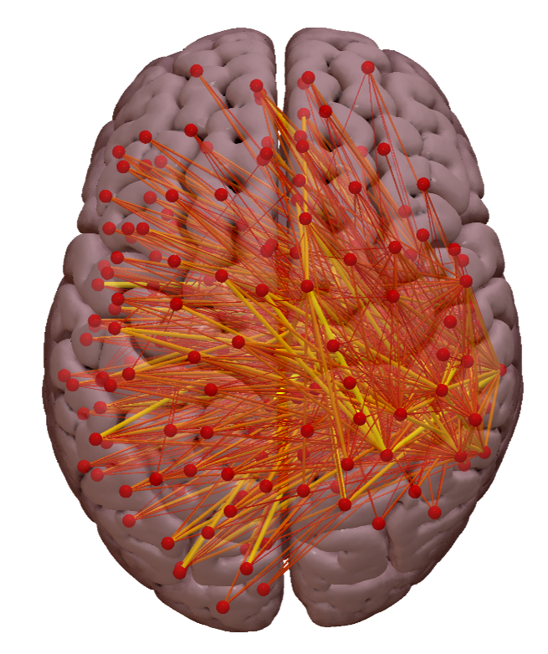
Overview
Lesion
1
VLBM (NiiStat)
2
Whole-brain Disconnection
3
Parcel-wise Disconnection
4
SSPLs
5

Slide 3
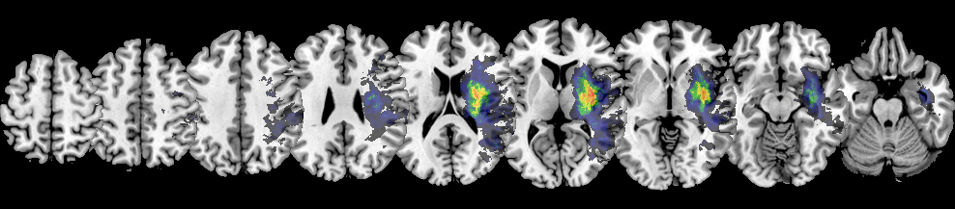
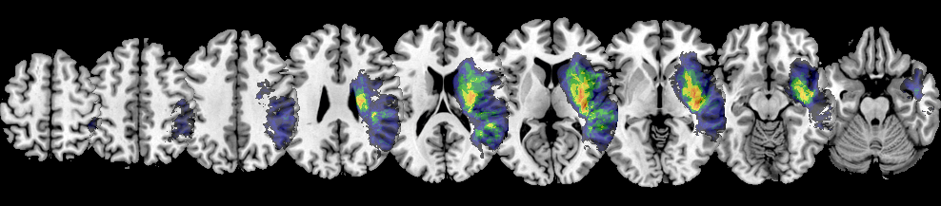
Lesion Overlap – Neglect Patients
1
Female
→ smaller?
→ more parietal
Male

Slide 4
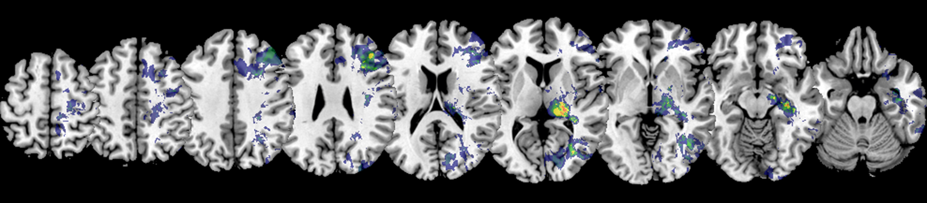
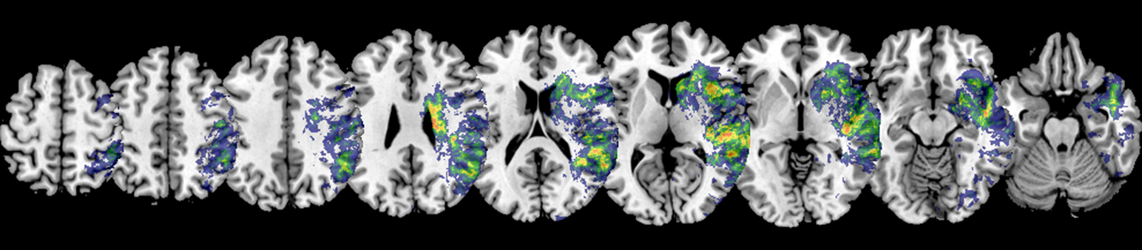
Lesion Subtraction – Neglect Patients
1
Female
→ Thalamus
Male

Slide 5
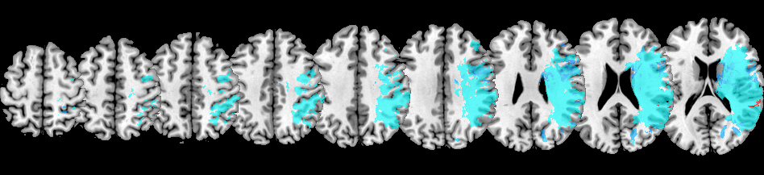
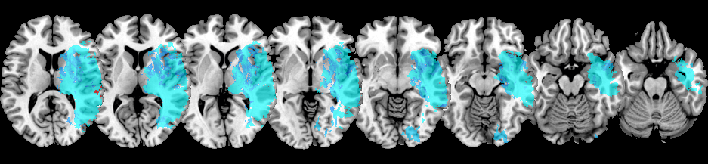
Lesion VLBM – Female Patients
2
→ lateral parietal
→ TPJ?

Slide 6
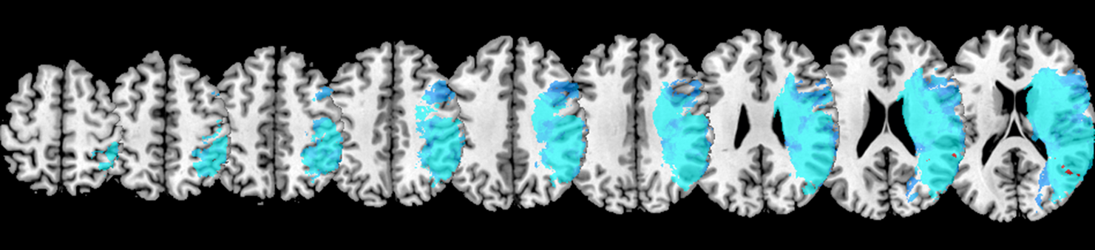
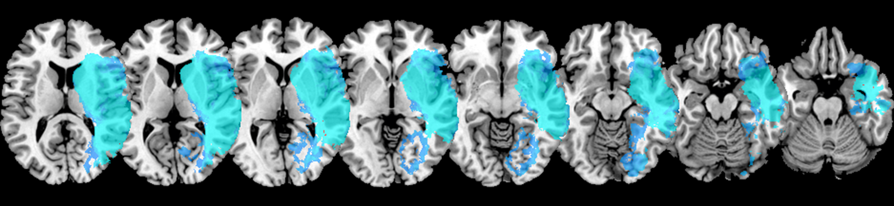
Lesion VLBM – Male Patients
2
Posterior to AG?

Slide 7
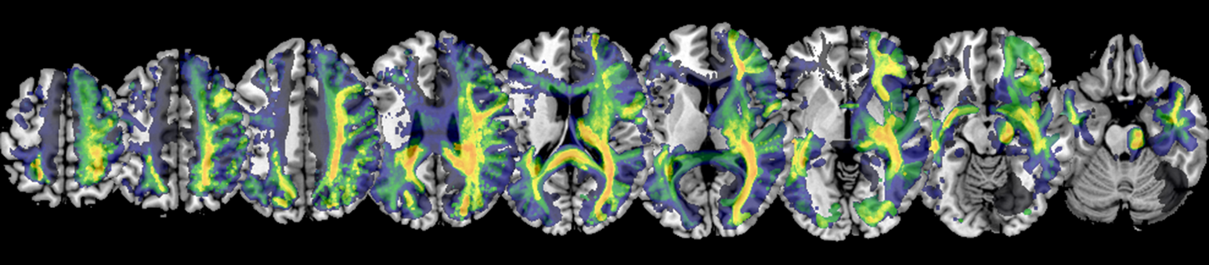
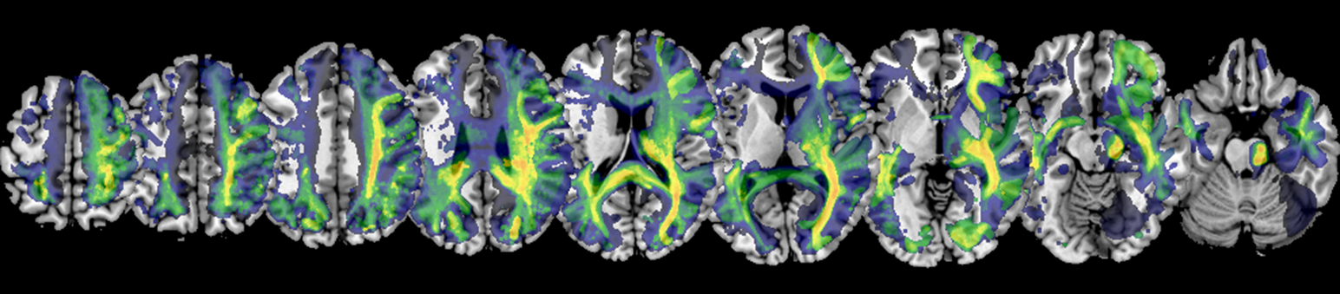
Whole-brain Disconnections – Neglect
UPDATE WITH NEGLECT OVERLAYS
3
X
Female
Thalamus
posterior
X
Male

Slide 8
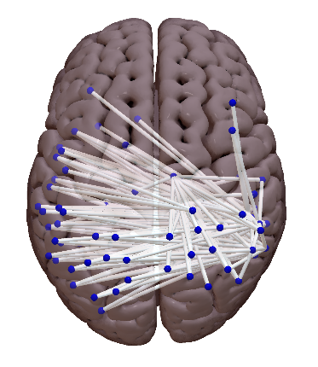
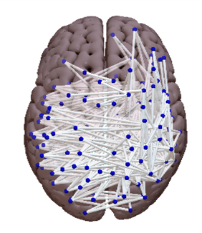
ROI-to-ROI Disconnections
4
Female
Male
n = 205
70.7% interhemispheric
Highest significance for intrahemispheric connections: Parietal/Temporal to Thalamus
n = 611
70% interhemispheric
Highest significance for interhemispheric connections: Parietal/Temporal
Overall higher significance levels
→ Same patterns for regular & Bayesian analyses

Slide 9
Shortest Structural Path Lengths (SSPLs)
5

